Slide 1
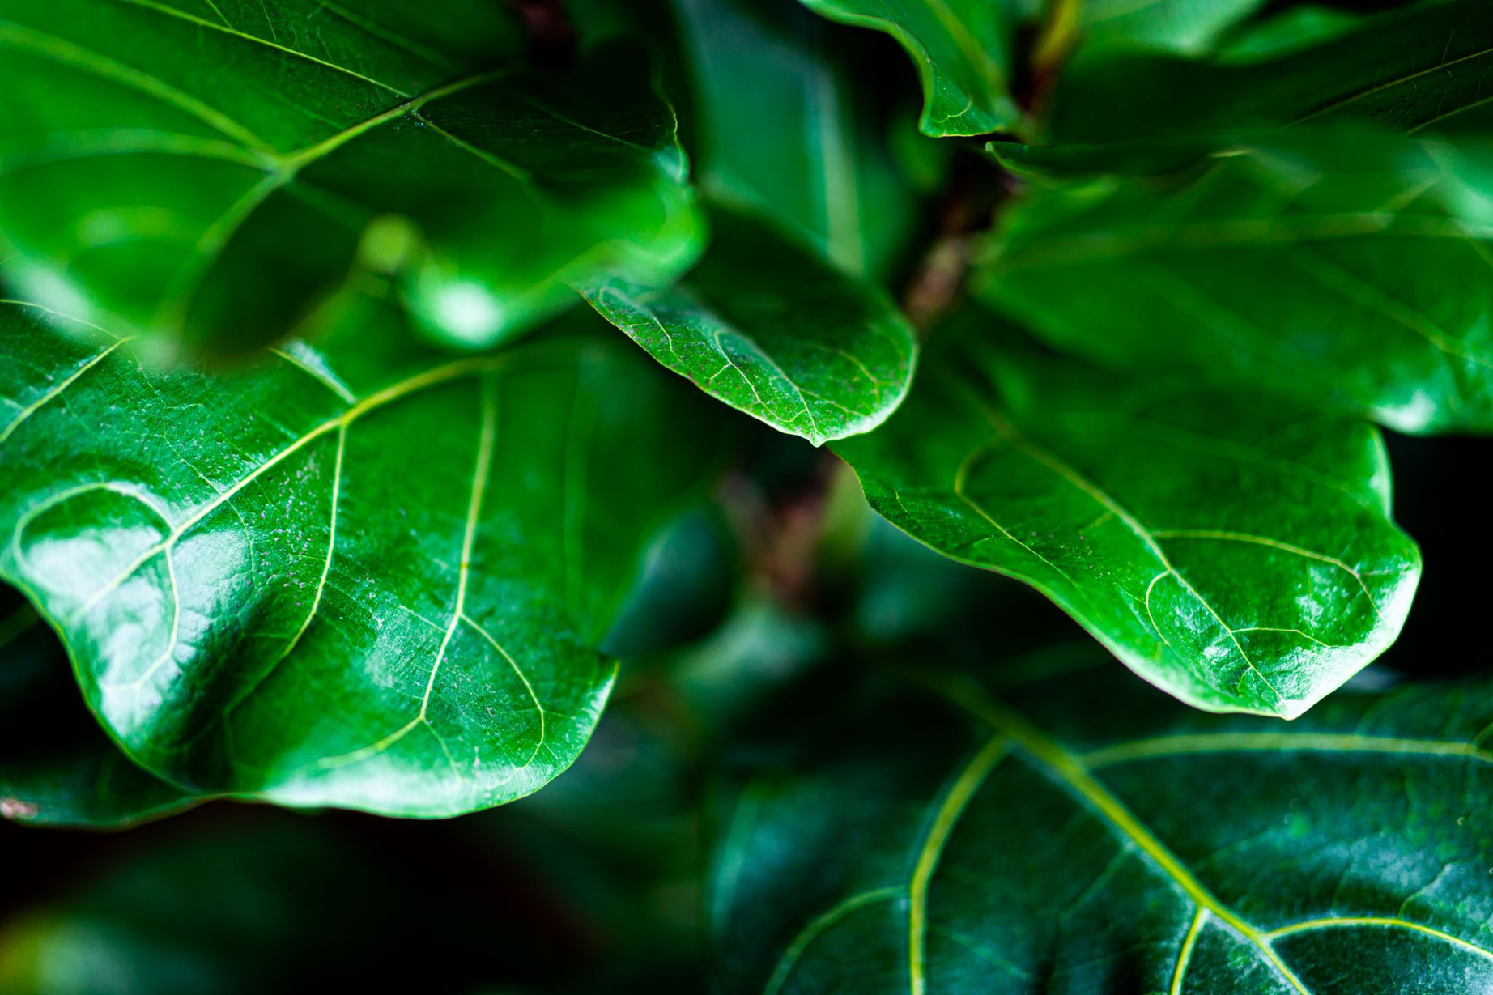

202101619010032 -> Sahil Koshti
202101619010054 -> Dhruv Patel
202101619010106 -> Aryan Parikh
202101619010116 -> Neha Daivat

Slide 2
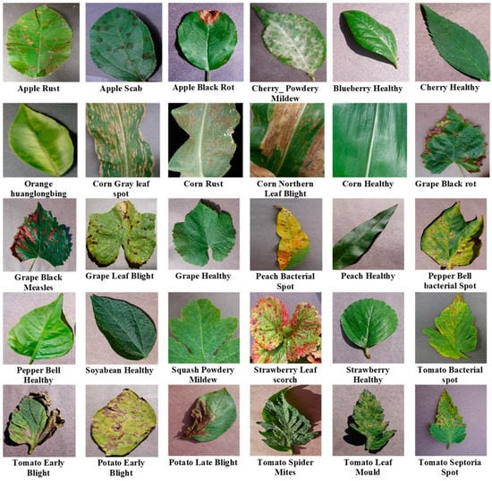
Intoduction
This project focuses on building a deep learning-based plant disease prediction system using images. By leveraging Convolutional Neural Networks (CNNs), we classify plant diseases and deploy a user-friendly web app with Streamlit. The entire system is packaged as a Docker container for easy deployment and scalability.

Slide 3


Key Insights:
Project Overview:
Building a system to predict plant diseases using images.
Training a CNN for image classification.
Web App Development:
Using Django for creating a user-friendly interface where users can upload images.
Implementing a classification button to get predictions.

Slide 4
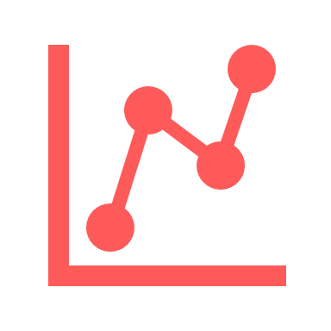


Key Insights:
Model Training:
Building a simple CNN with convolutional and pooling layers.
Training the model and evaluating its performance using loss and accuracy metrics.
Deployment:
Saving the trained model and class indices.
Dockerizing the Django app for deployment.
Running the app and creating a Docker container for better standardization and portability.
Conclusion:
Emphasizing the importance of model improvement through data augmentation and hyperparameter tuning.
Encouraging viewers to experiment with the provided code and repository for better understanding.

Slide 5
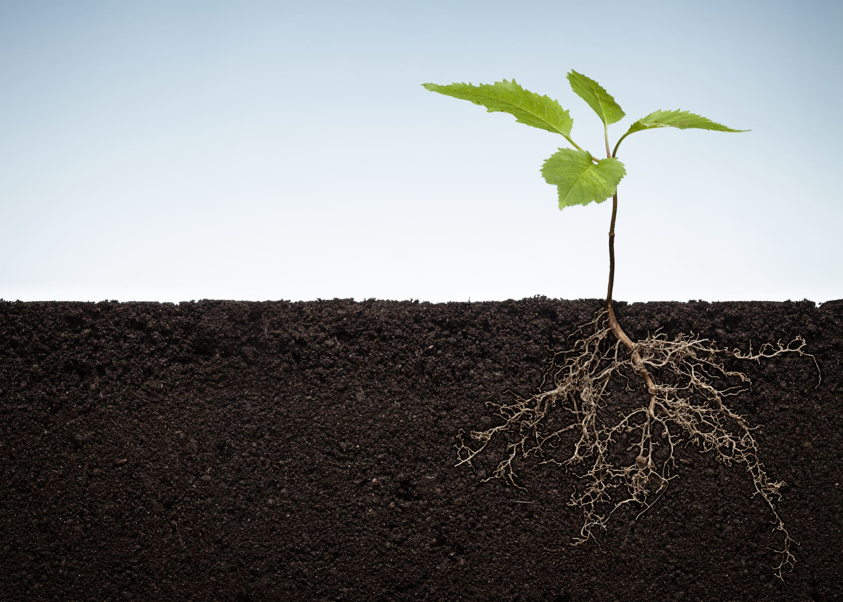
Plant Disease Process
Plant disease detection involves identifying the problem, collecting information, and then using a variety of methods to diagnose the disease.
Steps for diagnosing plant disease
Identify the plant or insect
Identify the signs and symptoms
Collect information about the plant's history and the environment around it
Research the problem
Gives Detail report about diseases

Slide 6

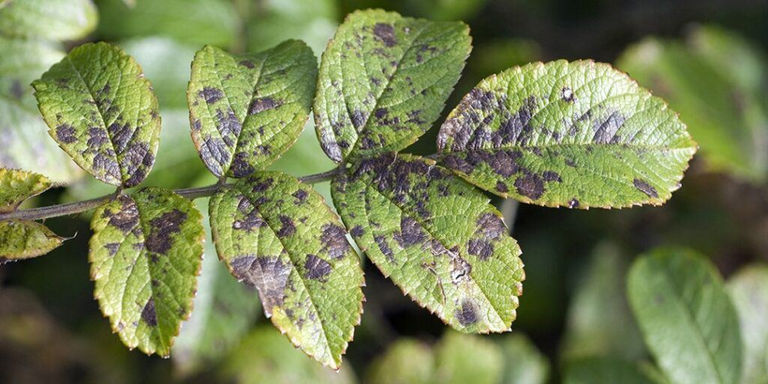


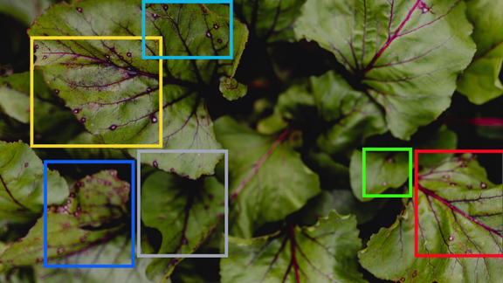
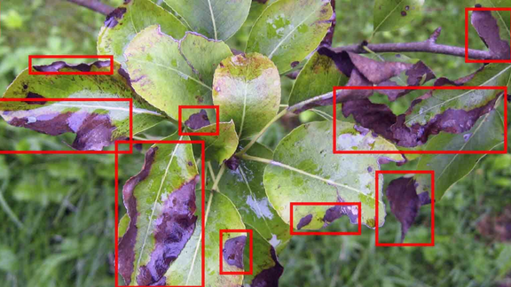
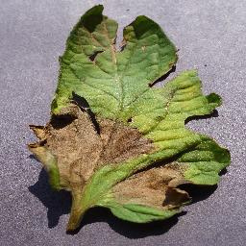


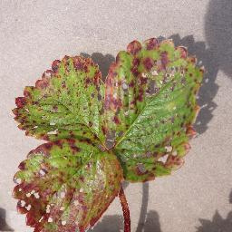
Plant Disease Process
Displaying Output
Deep learning
Output

Slide 7









JSON
MobileNet
TensorFlow
Tools &
Technology
Numpy
Machine Learning
Algorithms
Pandas
Python Django
GEMINI API

Slide 8





Chatbot
Develop an AI-based chatbot capable of answering queries related to plant diseases, soil, pesticides, and agriculture.
Multi-language support: Answers provided in English, Hindi, and Gujarati based on user preference.
Uses Gemini API for accurate and up-to-date information on plant diseases.
Backend powered by Django framework for robust user authentication, chat history storage, and API integration.
Frontend designed using responsive web design principles for optimal user experience.

Slide 9
Plant Disease Process
Plant disease detection involves identifying the problem, collecting information, and then using a variety of methods to diagnose the disase.
Steps for diagnosing plant disease
Identify the plant or insect
Identify the signs and symptoms
Collect information about the plant's history and the environment around it
Research the problem
Gives Detail report about diseases

Slide 10
Impact
Increased Agricultural Productivity – Early and accurate disease detection helps farmers take timely action, reducing crop loss and increasing overall yield.
Reduced Use of Chemicals – Farmers can apply pesticides and fungicides only when needed, leading to reduced chemical use and less environmental pollution.
Improved Food Security – By minimizing crop damage, the system helps ensure a stable food supply for growing populations.
Cost Efficiency – Early detection prevents major crop losses, reducing farmers' financial burden and increasing profitability.
Precision Agriculture – Integrating AI-powered detection with smart farming techniques enhances precision in disease management.

Slide 11
Benefits
Early Disease Detection – Identifies plant diseases in their initial stages, allowing farmers to act before serious damage occurs.
Time-Saving – Automated detection is faster and more efficient compared to manual inspection.
Better Crop Quality – Healthy crops result in better quality produce, increasing market value and consumer satisfaction.
Scalability – The system can be expanded to detect multiple plant diseases across different crops.
Integration with AI Chatbots – Farmers receive instant guidance on disease treatment and prevention through an AI-powered chatbot.
Educational Tool – Helps farmers and students learn more about plant diseases, their symptoms, and prevention techniques.

Slide 12
Pay-Per-Upload Model
Content :
Simple and Flexible
Pay only for what you use
Cost: ₹5 per image upload
Ideal for occasional users or those testing the service
No commitment required

Slide 13
Subscription Model
Unlimited Disease Detection
Cost-Effective for Regular Users
Plan Details:
1 Month: ₹100
3 Months: ₹300
6 Months: ₹550
12 Months: ₹900
Save more with longer subscriptions!
Access to all features

Slide 14
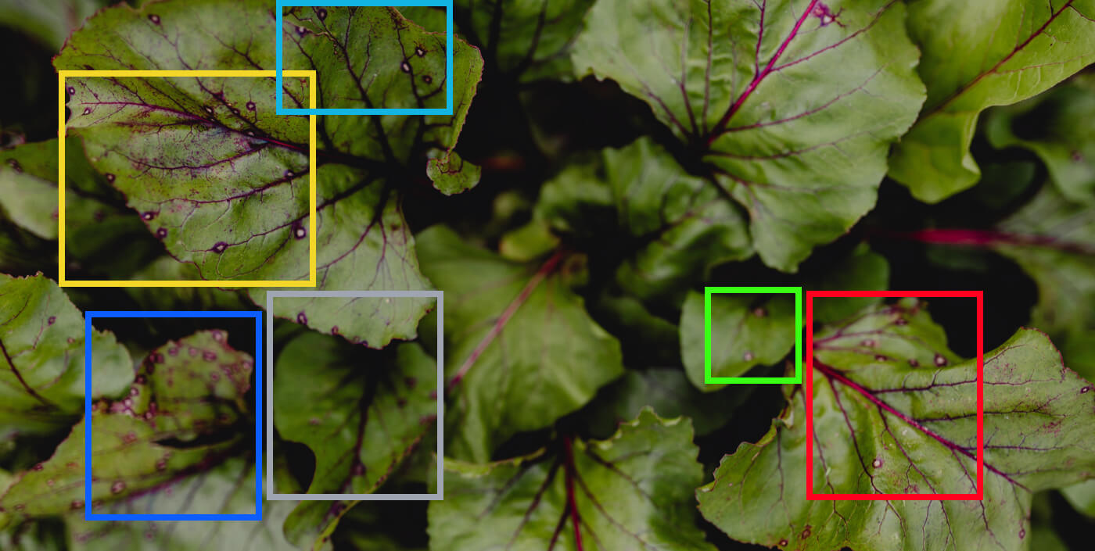
Plant Dieases

Slide 15
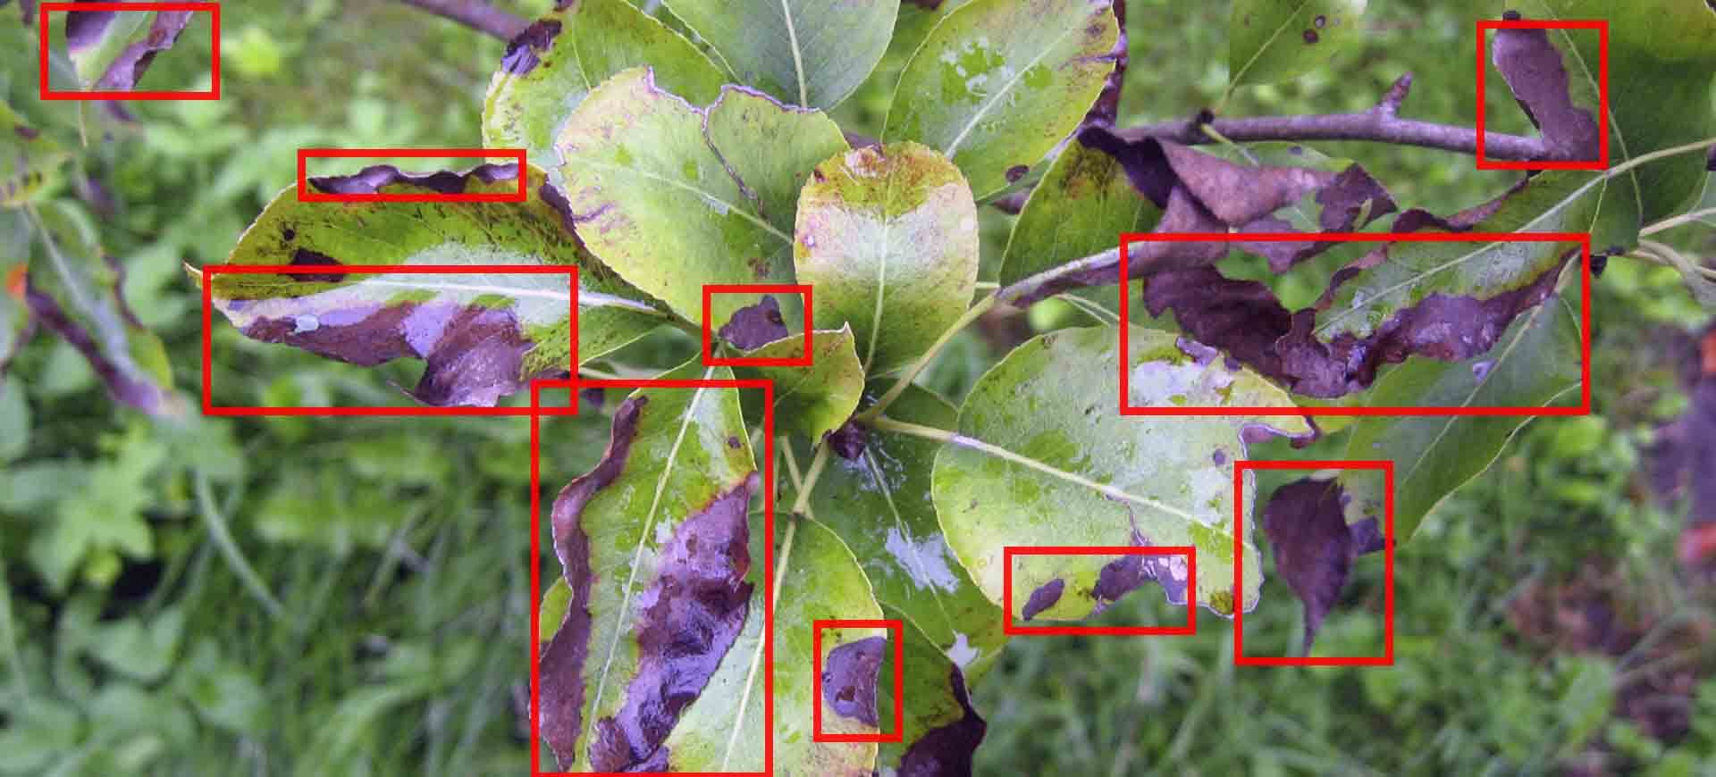
Plant Dieases

Slide 16
Thank You

